Slide 1
Key Terminology | Definition
Primary data | Data that is collected in the field
Secondary data | Data that was collected by another person.
Qualitative data | Opinion based data
Reliability | How representative your data /methods are
Bias | Anything that gives increases the chance of the data being unfair and incorrect
Sampling strategy | How you collected your data to reduce error and increase reliability
Sample size | The amount of data you collected. The greater the sample size the more reliable
Hypothesis | A statement that will be tested.
Enquiry question | A question asked to test a hypothesis / investigate a topic
Transect | A line along which surveys are taken
COMPONENT 3: FIELDWORK
Pose questions
Data presentation
Data analysis
Conclusions
Evaluation
Data collection
Paper 3 Key Themes | What is means
Qualitative Surveys | Qualitative surveys are opinion based - often using visual or word based answers Provides “quality” in depth data Hard to analyse Because opinion based – can be biased
Place | Investigating the features of locations to identify uniqueness of place e.g.: the characteristics of coastal features in two locations the characteristics of river features in two locations the characteristics of an ecosystem in two locations two villages or two urban environments quality of life in two neighbourhoods.
The Enquiry Process
Sampling Strategies
 | Selecting sites at a set interval e.g. every 100m. This avoids bias and ensures data is collected evenly | It is more straight-forward than random sampling A good coverage of the study area can be more easily achieved than using random sampling It is more biased, as not all members or points have an equal chance of being selected It may therefore lead to over or under representation of a particular pattern
 | When data is selected to match the characteristics of an area i.e. if 25% of a population is over 65 you would ensure 25% of your questionnaires were asked to OAPS | It can be used with random or systematic sampling, and with point, line or area techniques If the proportions of the sub-sets are known, it can generate results which are more representative of the whole population It is very flexible and applicable to many geographical enquiries Correlations and comparisons can be made between sub-sets The proportions of the sub-sets must be known and accurate if it is to work properly It can be hard to stratify questionnaire data collection, accurate up to date population data may not be available and it may be hard to identify people's age or social background effectively
 | When you select people / sites at random – this avoids the risk of bias, but may mean some areas are not covered | Can be used with large sample populations Avoids bias Can lead to poor representation of the overall parent population or area if large areas are not hit by the random numbers generated. This is made worse if the study area is very large There may be practical constraints in terms of time available and access to certain parts of the study area

Slide 2
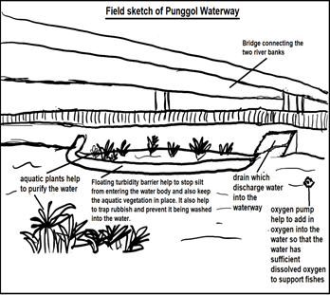
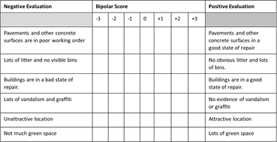
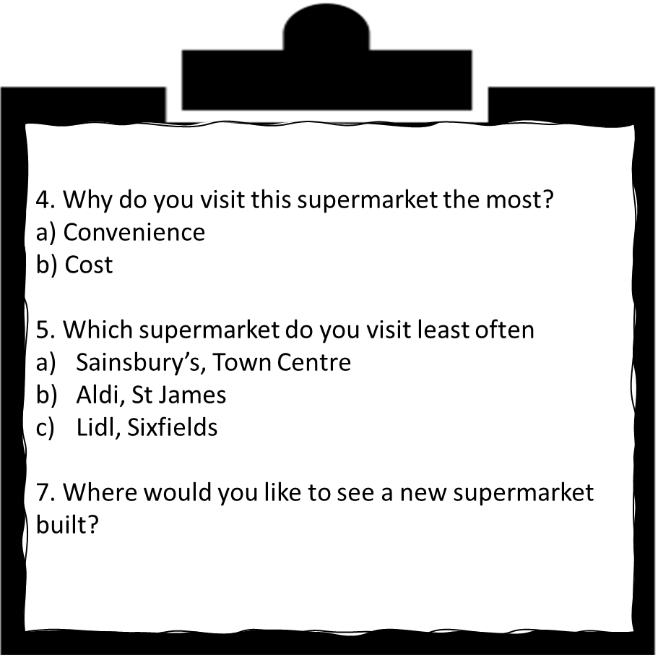
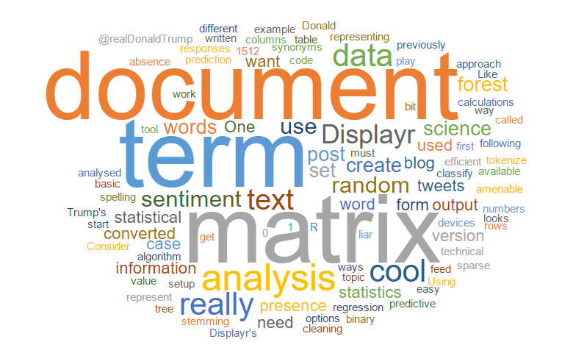
Fieldsketchs
Allows detailed labels
Focuses on key points
Time consuming
Drawing skills may be limited
Likert Survey
Quick / easy to understand
Positive and negative statements can be mixed up to ensure that respondents have to think about answers
People may tend to score near centre as an easy option
All statements equally important (unless weighting used)
Doesn’t quantify anything (even if you use numbers)
Bi-polars
Quick / easy to understand
People may tend to score 0 as an easy option
All statements equally important (unless weighting used)
Questionnaires
Quick - easy to collect large sample
Can use open questions – provides qualitative/ in depth responses but hard to analyse
Can use closed questions – easy to analyse, but “simplistic” data
Some people wont want to complete question – so sample may be biased
All statements equally important (unless weighting used)
Doesn’t quantify anything (even if you use numbers)
Analysing text
Word clouds can be used to show frequency
Hard to know extract frequencies
Text can be colour coded to show patterns
Coding text subjective – risk of bias
Method | Pros | Cons
News Articles | Includes interviews and other information we can not easily access Easy to search for and can include historic information | Bias – Newspapers may pick sensational stories Dated May be incorrect
Use of internet | Saved us time as searches provided thousands of results in minutes Cost effective Easy access Data is extensive | Data may be inaccurate as many figures were not referenced Out of date May be biased Lack of quality control
Census Data | Reliable as has to be completed by law Provides range of socio economic data | 11 years out of date
Social Media | Gives access to peoples opinions Big data – millions of posts can be searched | Hard to analyse Many groups e.g. OAPS might not use Twitter etc Opinions often biased or sensationalised to act as click bait

