Slide 1
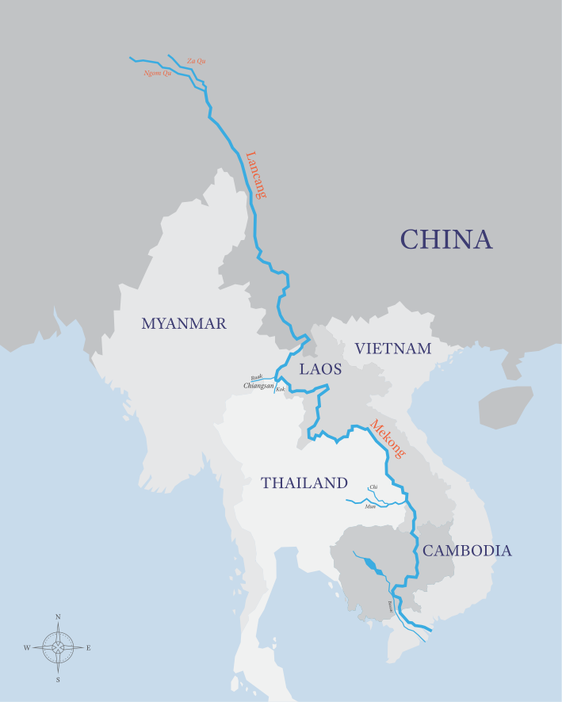
Environmental Challenges
Mekong River – A transboundary water issue
read
quiz
The Big Picture
Key Terms
How ecosystems function
Ecosystems under threat
Economic Issues – Factors relating to money e.g. will it make people rich/poor.
Environmental Challenges
Environmental Issues – how the natural environment will be affected.
*Water resources and management
Desertification
Estuary Characteristics
Social Issues – how a management method will affect people.
Mekong River
Estuary Characteristics
The Mekong River, located in southeast Asia is the 12th longest river. The river flows through six countries from its source in China to its mouth in Vietnam.
Social Issues
China
People displaced e.g. 200,000 when Xayaburi dam constructed.
Properties flooded when water is released to protect dams following heavy monsoon rain e.g. 1,571 families affected in September 2015. Safe and reliable sources of water.
Cambodia
Less water is available for people and farms.
The scale of flooding during the monsoon season is now smaller, protecting more properties.
Estuary Characteristics
Economic Issues
China
Loss of farmland as reservoirs form.
Jobs in construction and hydroelectric power.
Cheap hydro-electric power has supported the growth of China’s economy
Cambodia
Reduced water levels and river velocity cause increased deposition, which has led to the formation of sandbanks that impede navigation.
Fish stocks have been reduced, leading to a drop in income for fishermen.
Monsoon floods are much smaller, meaning less sediment is deposited, reducing the fertility of valuable agricultural land used for rice farming.
The Mekong River has traditionally experienced seasonal changes in discharge. During the monsoon season, extensive flooding has occurred along the course of the river. Outside of the monsoon season, the region has experienced significant droughts.
Estuary Characteristics
Environmental Issues
China
Issues
Vast areas of land have been flooded to form reservoirs, destroying ecosystems.
Constructing dams along the river in China has interfered with the river’s discharge downstream.
Cambodia
The natural flow of the river has been disrupted leading to the disruption of ecosystems.

