Slide 1




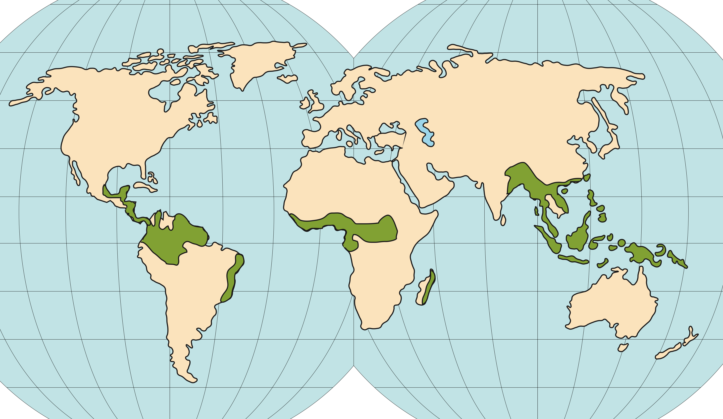










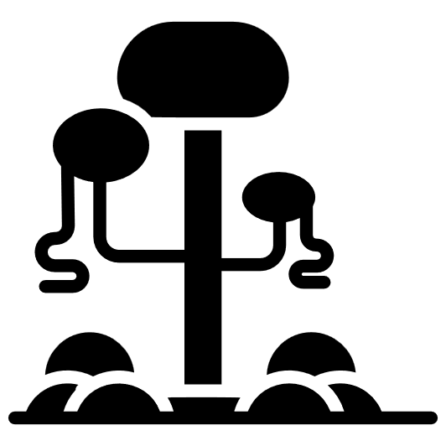





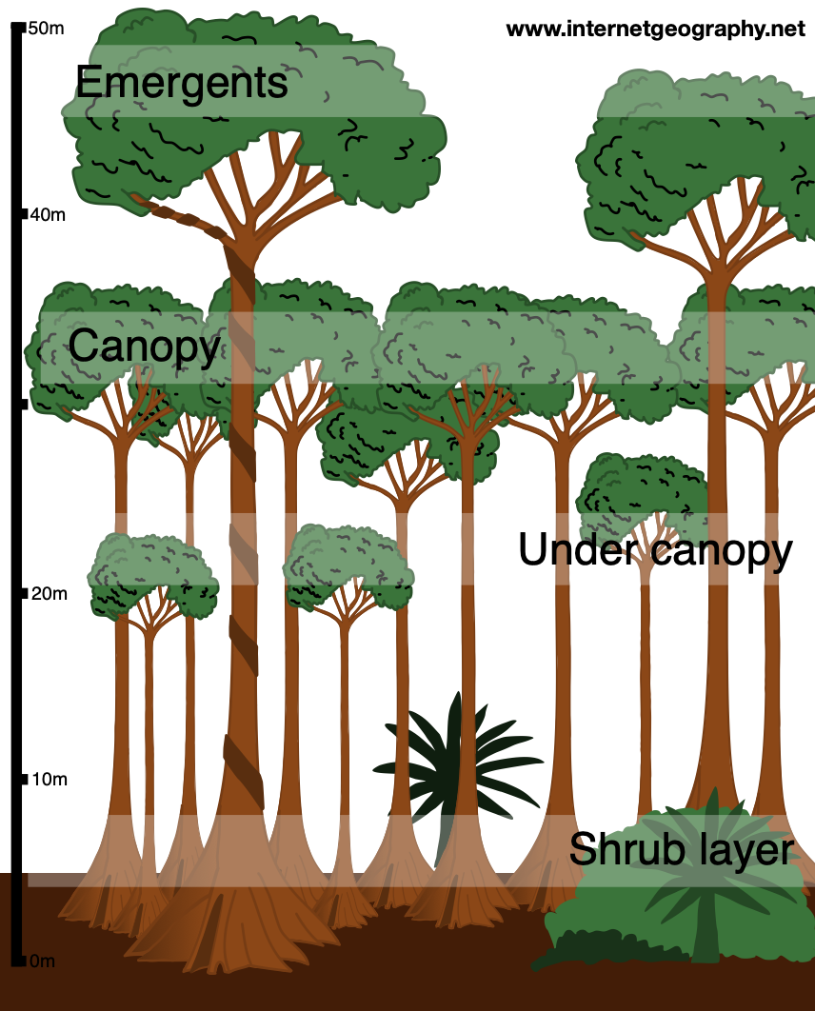

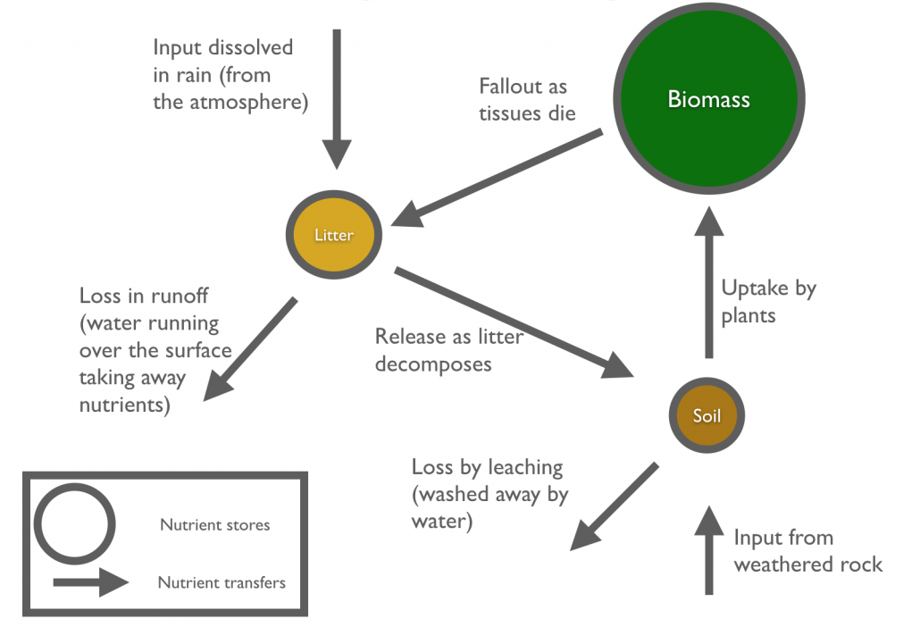
THE LIVING WORLD
Rainforests
read
quiz
Location
Key Terms
10°N and 10°S
of the Equator
South America
(Amazon), the
DRC (Africa),
Indonesia &
Malaysia (Asia)
Biome – Areas of the planet with a similar climate and landscape, where similar animals and plants live.
Biodiversity – The variety of life in the world or a particular habitat.
Characteristics
Commercial farming – Farming to sell produce for a profit.
Climate - High temperatures (27°C) and high rainfall (2000mm +)
Debt reduction – National debt relief
in return for protecting rainforests.
Water – Distinct wet season lasting several months. Leaching during this time.
Deforestation – The chopping down and removal of trees.
Soil – Not very fertile. Nutrients concentrated in the topsoil & quickly absorbed.
Ecotourism – Responsible travel to natural areas that conserves the environment and benefits locals.
Biotic – Highest biodiversity in the world. Thousands of species of plants and animals.
Logging – Cutting down trees and selling the timber.
People – Traditional tribes live sustainably. Exploitation for $$ gain by non-indigenous.
Soil erosion – Removal of topsoil faster than it can be replaced.
Adaptations
Sustainability – Progress meting todays needs with affecting future generations.
Emergents and lianas grow to
reach the sunlight.
The Nutrient Cycle
Buttress roots anchor the trees
in the shallow soil.
Smooth bark to deter epiphytes.
Plants have thick, waxy leaves & drip tips to channel water.
Poison Dart Frog - bright colours deter predators.
Sloths - long, sharp claws that help them cling onto branches.
Spider Monkey - prehensile tail to be able to grasp the branches of trees.
Jaguars - large claws, which enable them to climb small trees and catch their prey.

