Slide 1
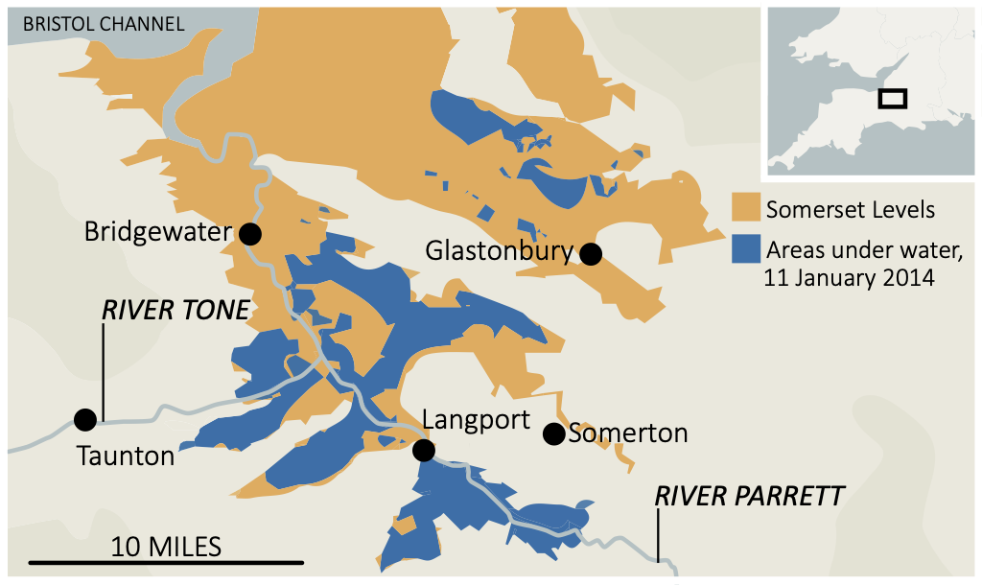
Rivers
read
Somerset Levels Flood
quiz
Background
A quick succession of prolonged Atlantic storms, with persistent rainfall and gale-force winds, was the primary cause of flooding. The rivers could not cope with the significant amount of rain that fell. Additionally, high tides in the Bristol Channel and its narrowing created tidal surges.
Heavy Rain
Atlantic depressions brought dropped 350 mm of rain in Jan and February 2014.
High Tide
High tides and storm surges prevented water from rivers draining into the sea.
Lack of
dredging
High sediment levels in rivers as no dredging for 20 years.
Social Impacts
Environmental Impacts
More than 600 homes flooded.
Sixteen farms evacuated.
Residents required temporary. accommodation for several months.
Some villages were cut off.
Power supplies were disrupted.
River water was contaminated with sewage, oils and chemicals.
A large volume of debris was deposited across the Somerset Levels.
Stagnant water had to be reoxygenated then pumped back into rivers.
Economic Impacts
Management
Over 14,000 hectares of agricultural land flooded for months.
Over 1,000 livestock had to be evacuated from farms.
Roads were cut off.
Railway lines were closed.
It is estimated the flooding caused £10 million of damage.
River banks have been raised and straightened.
£20 million was pledged on a flood action plan by Somerset County Council.
Dredging occurred on the River Tone and Parratt in March 2014.
Road levels have been raised.
Flood defences have been constructed for communities at risk.
Pumping stations have been constructed.

